Slide 1
Smoke-Signals
Anna Finkelstein, Zachary Mothner, Danielle Rozenblit, Alex Mina

Slide 2
Our Goal:
Create a physically-based offline smoke simulator based on Fedkiw’s paper Visual Simulation of Smoke
Why?
Used frequently in VFX applications
Fluid simulations used for computational flow dynamics
Used to simulate particle dispersion (contaminants etc.)
Smoke looks cool!

Slide 3
Our Approach:
Used a MAC Grid to discretize the computational domain into identical voxels.
Followed a Semi-Lagrangian advection scheme with monotonic cubic interpolation in order to advect Velocity, Density, and Temperature.
Re-injected the energy lost due to numerical dissipation back into the fluid using vorticity confinement.
Forced the velocity field to be incompressible by solving a poisson pressure equation.
Wrote grid density states at each timestep to ‘.vol’ export files that could be rendered using the mitsuba2 renderer.

Slide 4
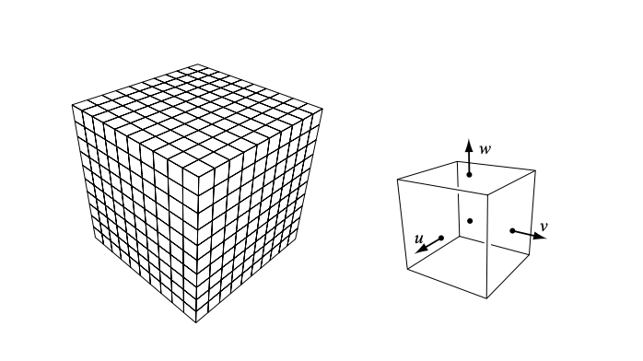
Discretization
Used a MAC Grid to discretize the computational domain into identical voxels.

Slide 5
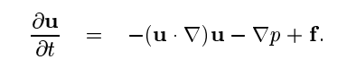
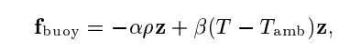
Advection
Followed a Semi-Lagrangian advection scheme with monotonic cubic interpolation in order to advect Velocity, Density, and Temperature.

Slide 6
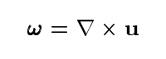
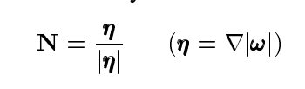
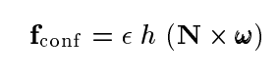
Vorticity Injection
Re-injected the energy lost due to numerical dissipation back into the fluid using vorticity confinement.
Notes:
Advection / Interpolation causes dissipation of the velocity and loss of local small-scale details - a vorticy confinement force is used to re-inject this energy back into the fluid’s velocity fiels

Slide 7
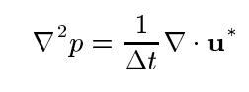
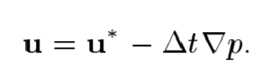
Pressure Projection
Forced the velocity field to be incompressible by solving a pressure-poisson equation and subtracting the pressure gradients from the intermediate velocity field.
Notes:
We force the intermediate velocity field to be incompressible by solving a pressure-poisson equation,

Slide 8
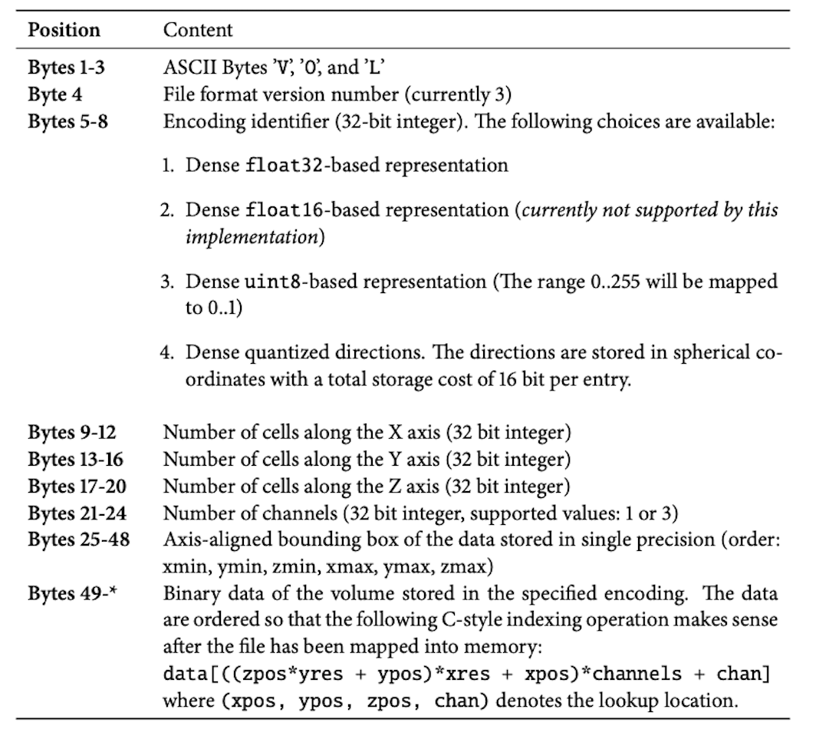
Offline Rendering
Wrote grid density states at each timestep to ‘.vol’ export files that could be rendered using the mitsuba2 renderer.

Slide 9
Challenges
We found advection and pressure projection particularly conceptually challenging
We had a bug deep in our original data structure
Complete overhaul of the code!

Slide 10
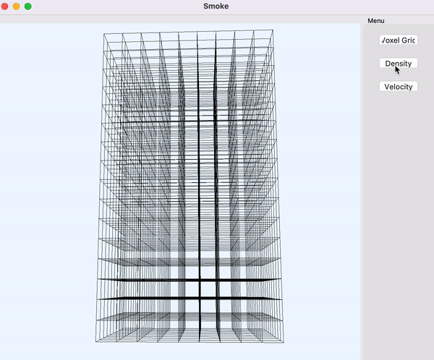
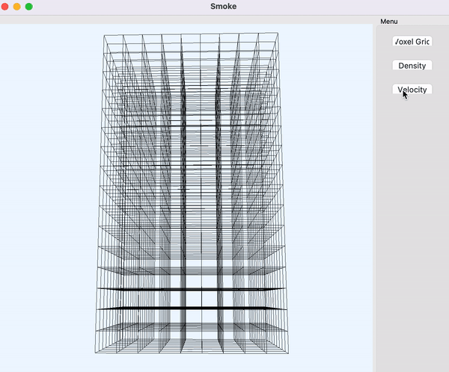
Results! Coarse Real-Time Results
OpenGL used to visualize simulation and gather coarse results
Left: densities shown using pseudo-particle representation (random particles generated)
Right: velocities shown using arrows, with magnitudes represented by size

Slide 11
Results! Our Smoke Plume!

Slide 12

Just kidding… here’s a real video

Slide 13

Results! Smoke-Smoke Interaction

Slide 14
Division of Work
Real-time VDB
Alex
Advection, Poisson Pressure Solver, Vorticity Injection, Offline Rendering
Anna, Zach, Danielle

